Slide 1





Fast Tile-Based Adaptive Sampling With User-Specified Spectra
Florent Wachtel¹ – Adrien Pilleboue¹ – David Coeurjolly² – Katherine Breeden³ – Gurprit Singh¹ – Gaël Cathelin¹ – Fernando de Goes⁴ – Mathieu Desbrun⁴ – Victor Ostromoukhov^{1,2}
1
2
3
4

Slide 2
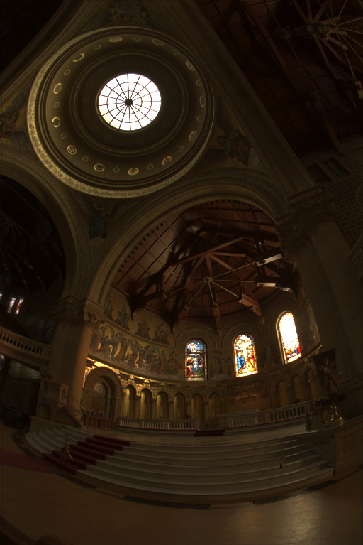
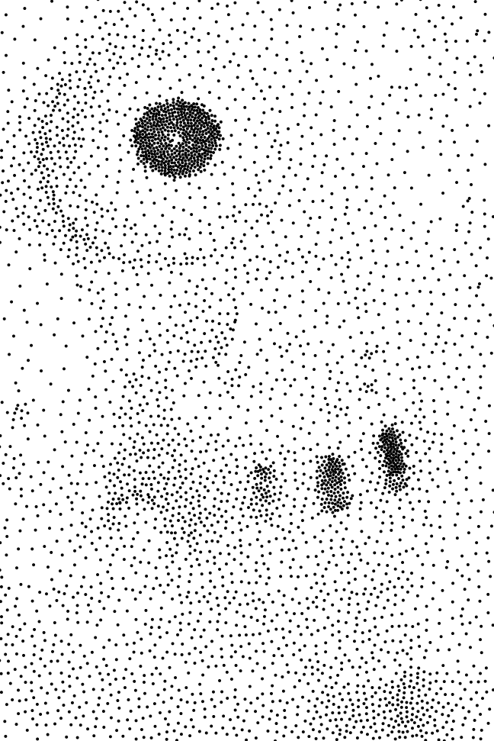


Problem Statement
Find a discrete sample distribution with density locally proportional to d(x, y)
Given a density function d(x,y)
courtesy of P. Debevec

Slide 3
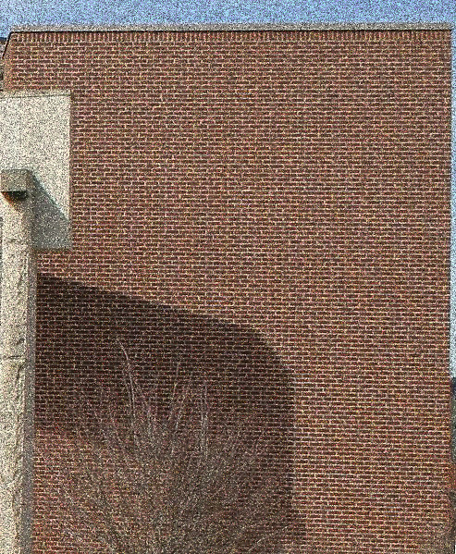
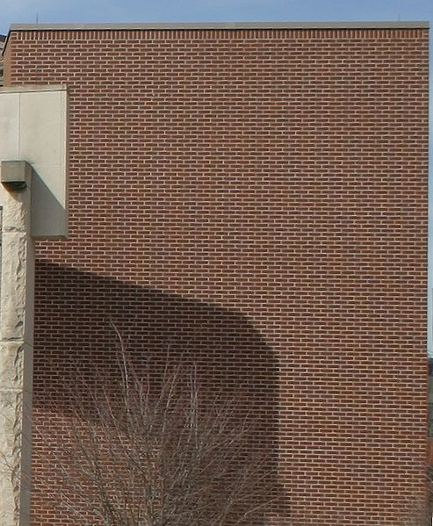
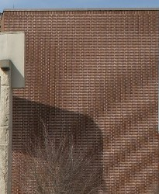
Why it is essential?
Two main issues when sampling a function:
Noise = not enough samples
Reference
Aliasing = sampling pattern

Slide 4

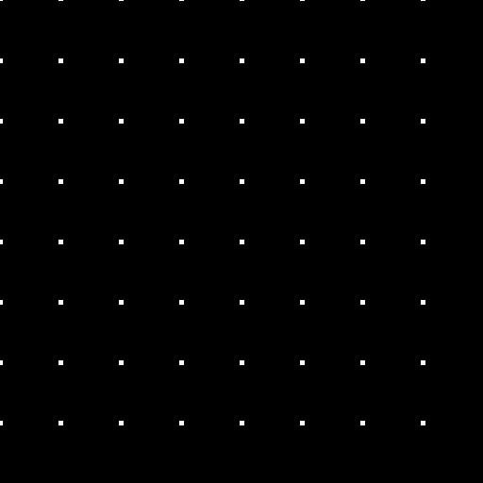


Context
Regular Sampling
Random Sampling
Pro: Uniform
Con: Aliasing when sampling frequency is below Nyquist frequency
Pro: No regularity
All frequencies equally sampled
Con: Voids and Clusters
Distribution
Fourier Spectrum
Distribution
Fourier Spectrum

Slide 5

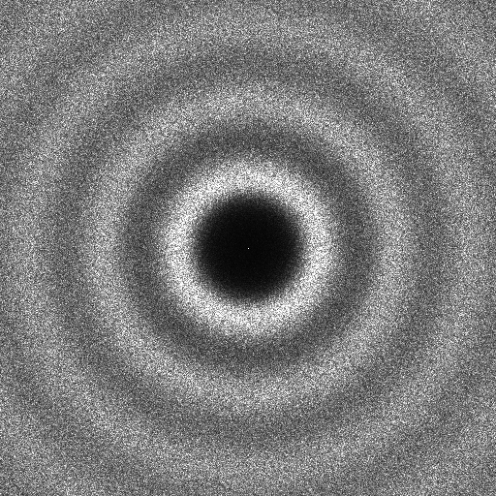

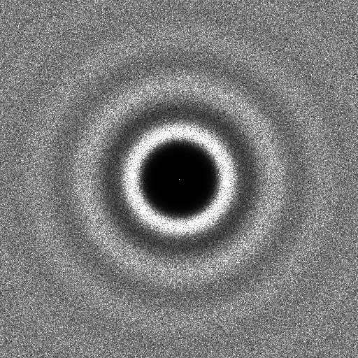
Previous work: Advanced Methods
Poisson Disk Methods
Optimization-based Methods
Stochastic
Force uniformity with exclusion disk
[Cook 1986][McCool et al. 1992][Wei 2008]
Minimize energy function
[Balzer et al. 2009][Fattal 2011]
[Schlomer et al. 2011][de Goes et al. 2012]
Distribution
Fourier Spectrum
Distribution
Fourier Spectrum

Slide 6



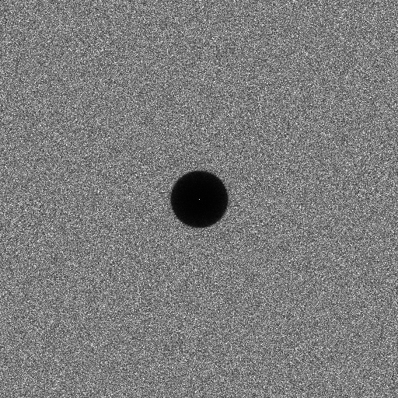
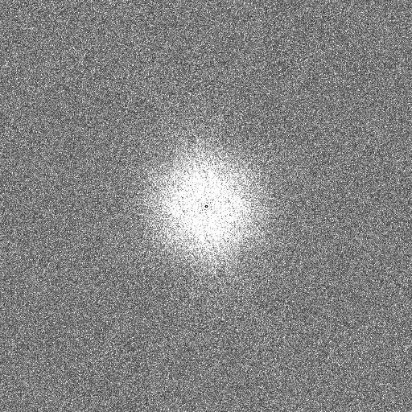
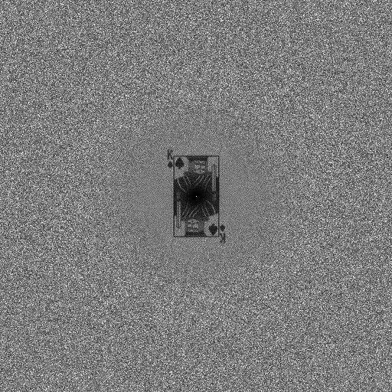
Previous work: General Noise Methods
Each application requires its own spectral characteristics
[Wei et al. 2011][Zhou et al. 2012][Oztireli et al. 2012][Heck et al. 2013]
Step noise
Pink noise
King noise
Distribution
Distribution
Distribution
Fourier Spectrum
Fourier Spectrum
Fourier Spectrum

Slide 7
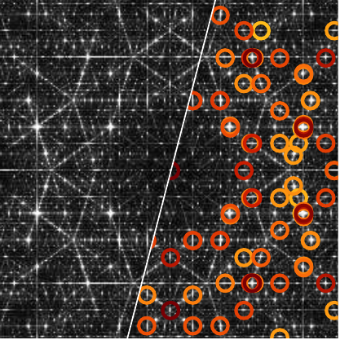
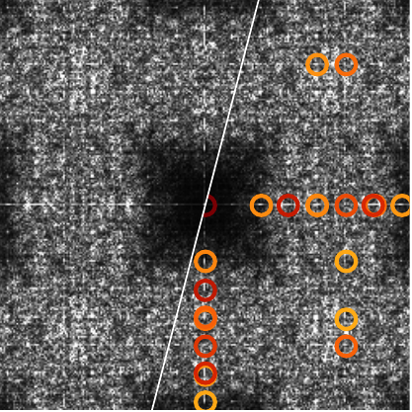
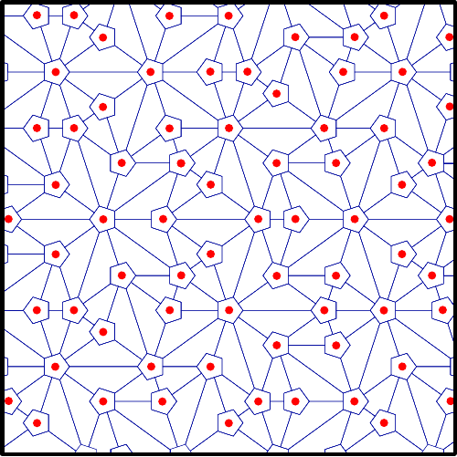
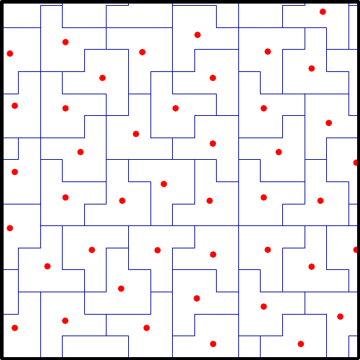
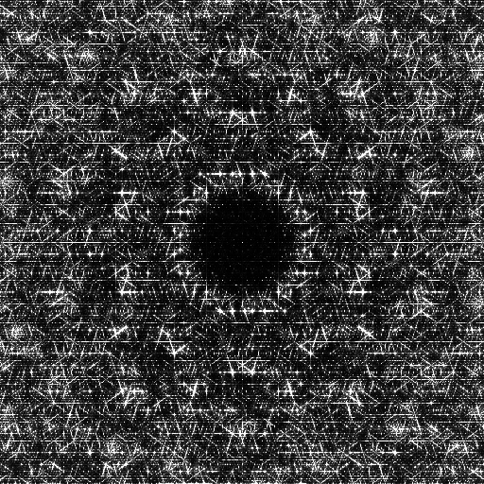
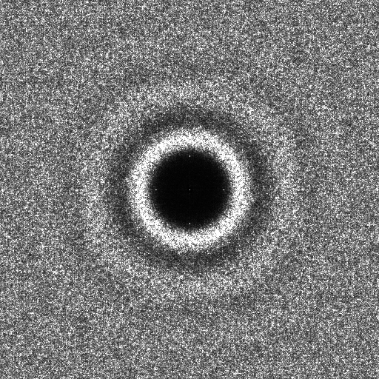
Previous work: Tile-based Methods
Store precomputed samples in a hierarchical and non-periodic tiling system
[Ostromoukhov et al. 2004, 2007] [Kopf et al. 2006] [Lagae et al. 2006]
Penrose Tiling
Polyominoes Tiling
before optimization
before optimization
Fourier Spectrum
Fourier Spectrum
after optimization
after optimization
Distribution
Distribution

Slide 8
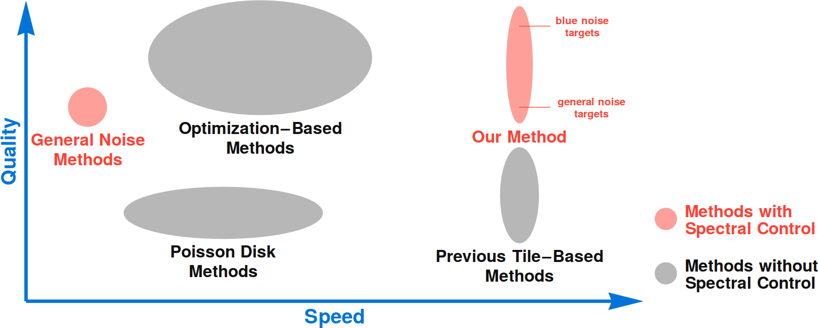
Previous work: Positioning

Slide 9
Previous work: Positioning
 | Poisson Disk | Optimization-based | General Noise | Tile-based | Our System
Quality | + | + + | + | ‒ | +
Efficiency | ‒ | ‒ | ‒ ‒ | + + | + +
Spectral Control | ‒ | ‒ | + | ‒ | +

Slide 10
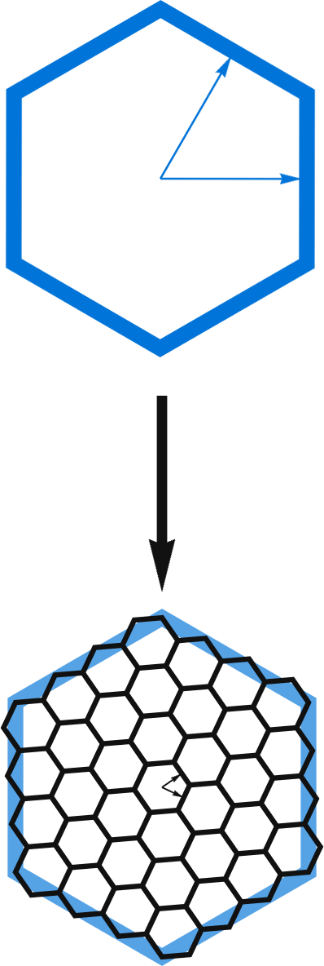
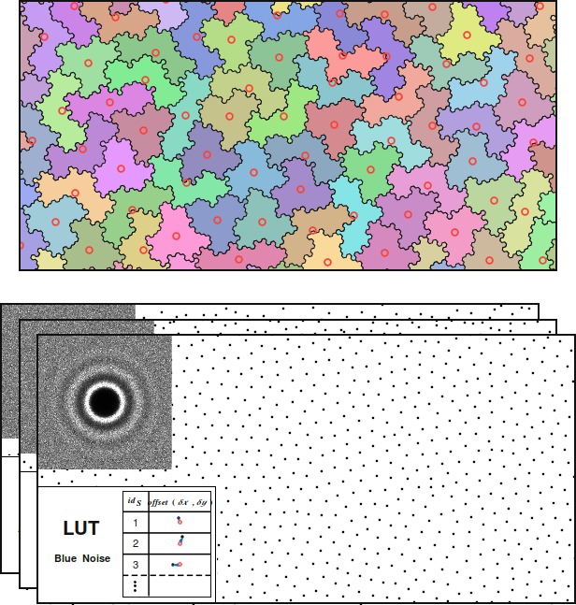
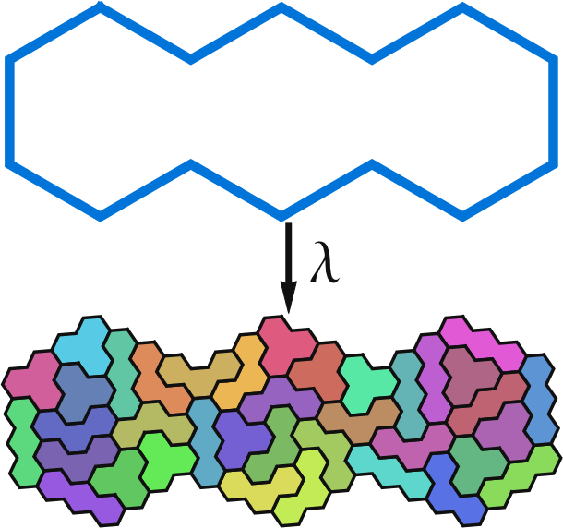
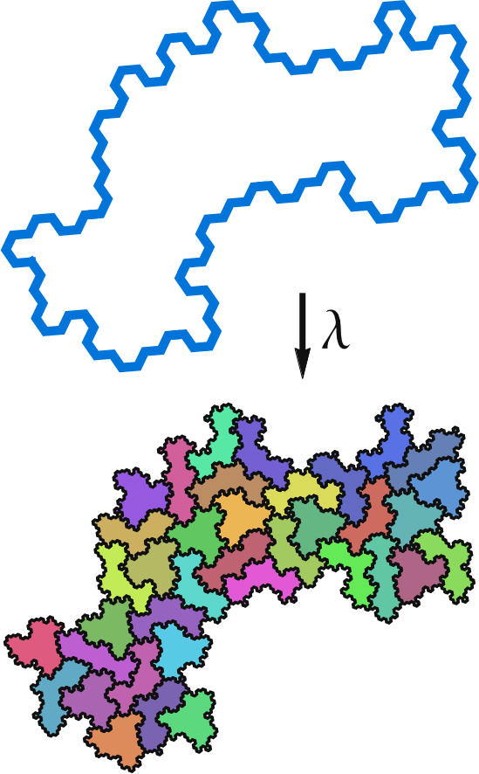
Outline
Hierarchical Tiling
Non-periodic Tiling
No pattern/regularities
Spectral control

Slide 11
Outline
Hierarchical Tiling
Non-periodic Tiling
No pattern/regularities
Spectral control

Slide 12
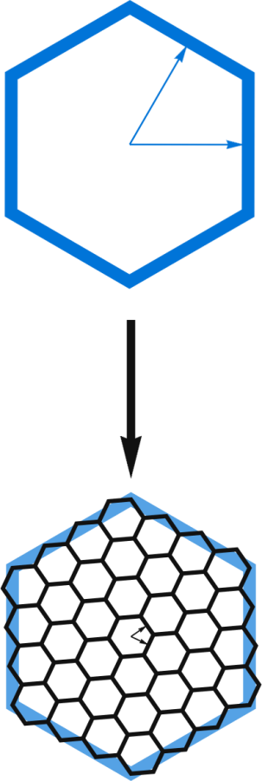
Outline
Hierarchical Tiling
Non-periodic Tiling
No pattern/regularities
Spectral control

Slide 13
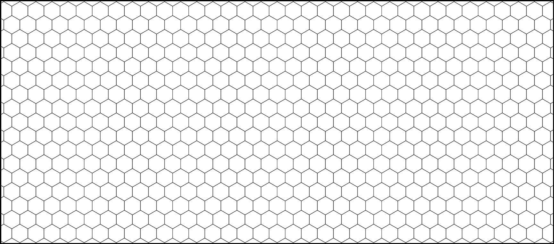
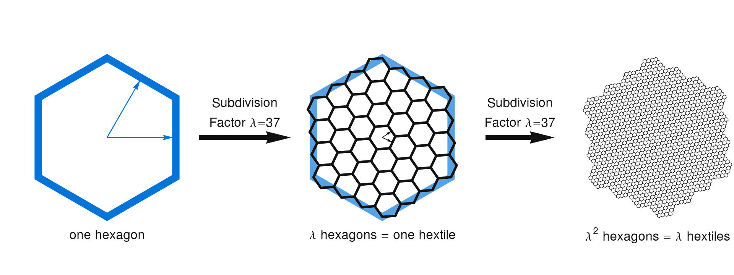
Base lattice
Hexagonal lattice
Recursive subdivision scheme

Slide 14
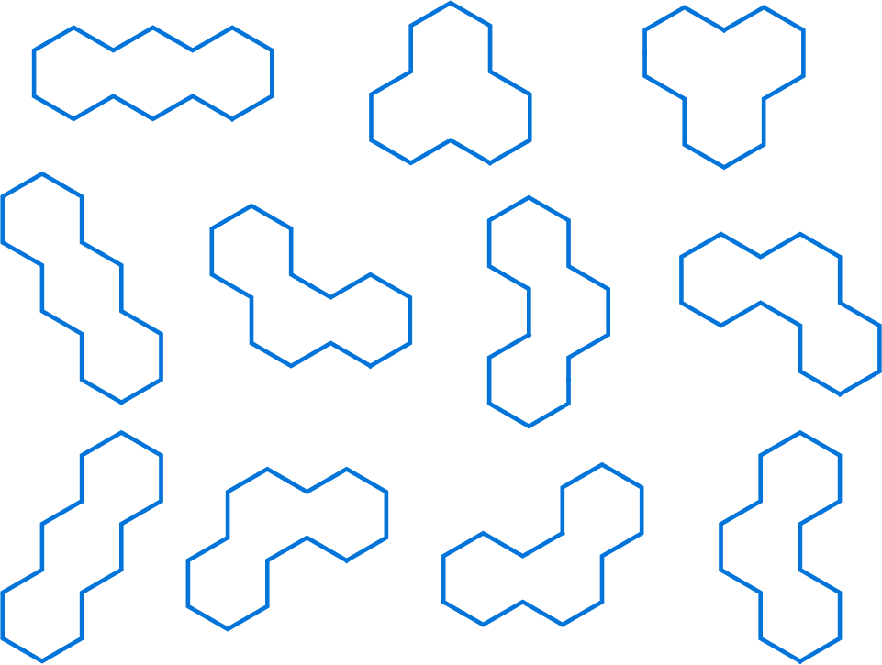
Polyhexes & Subdivision
11 possible trihexes
Subdivision rule for each trihex

Slide 15
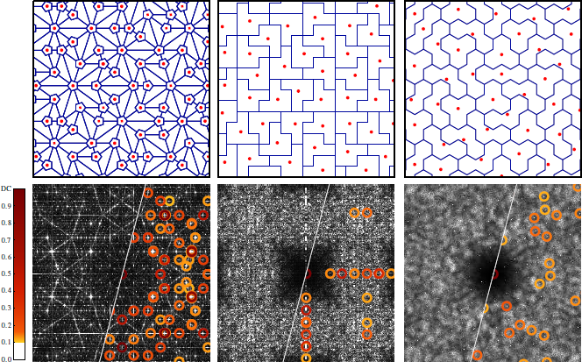
Comparison with previous systems
Penrose
Polyominoes
Trihexes

Slide 16
Irregular quasi-hexagonal lattice
Start from a standard hexagonal lattice

Slide 17
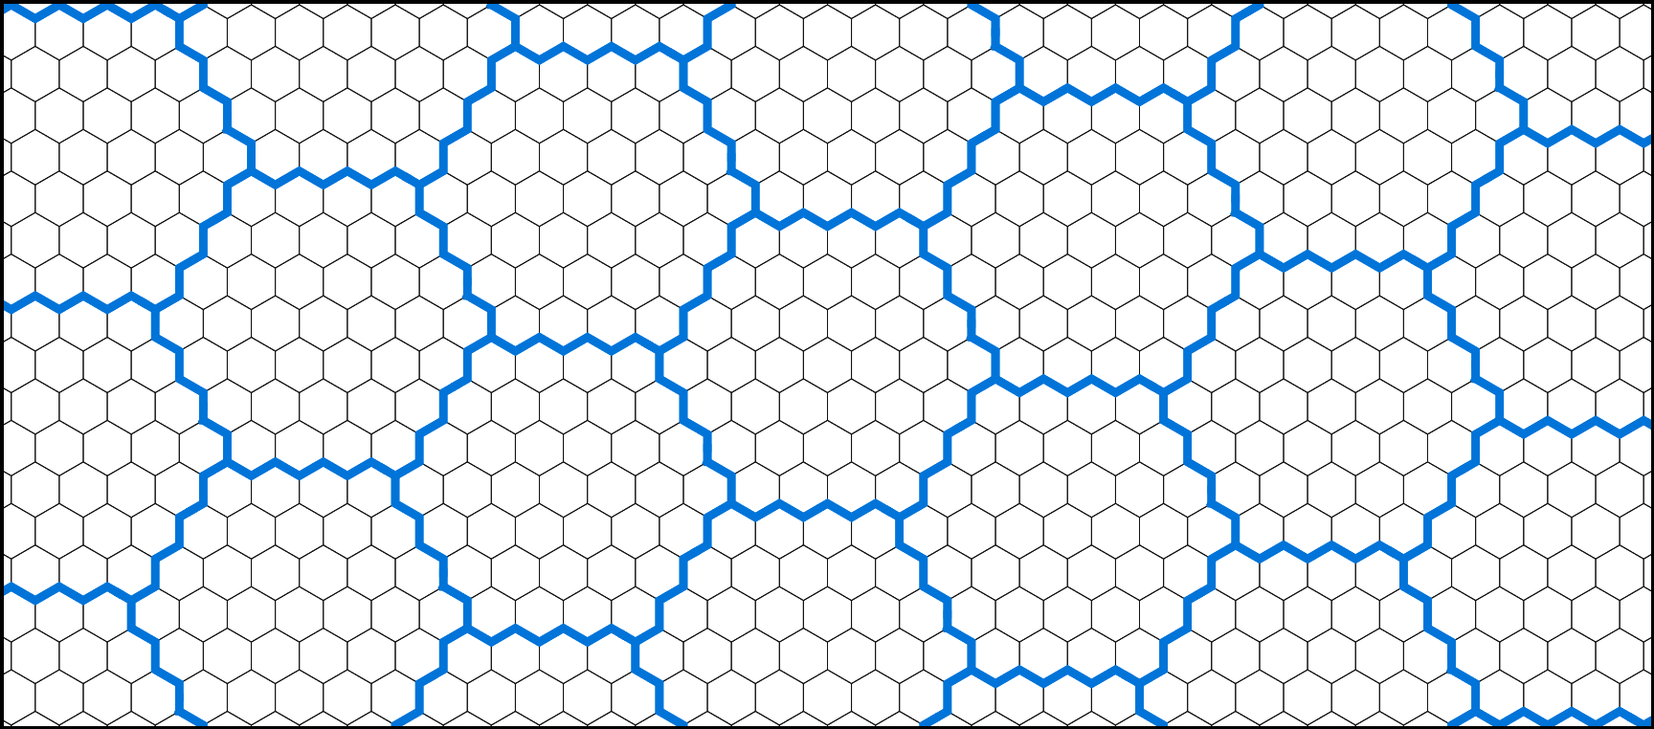
Irregular quasi-hexagonal lattice
Construct a quasi-hexagonal lattice of hextiles

Slide 18
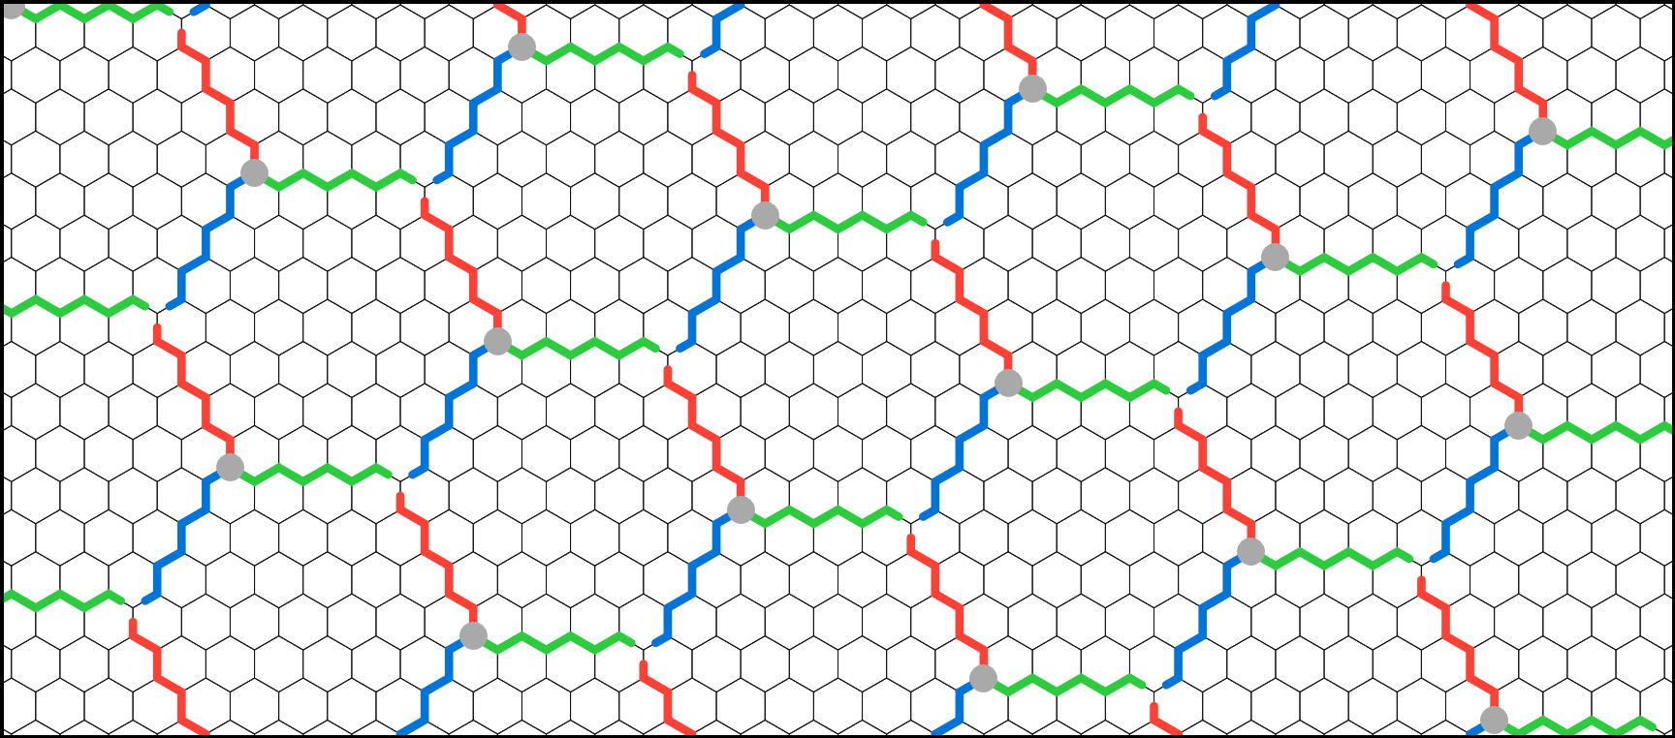
Irregular quasi-hexagonal lattice
Reassign hextiles borders to obtain triple-edge modifiers

Slide 19
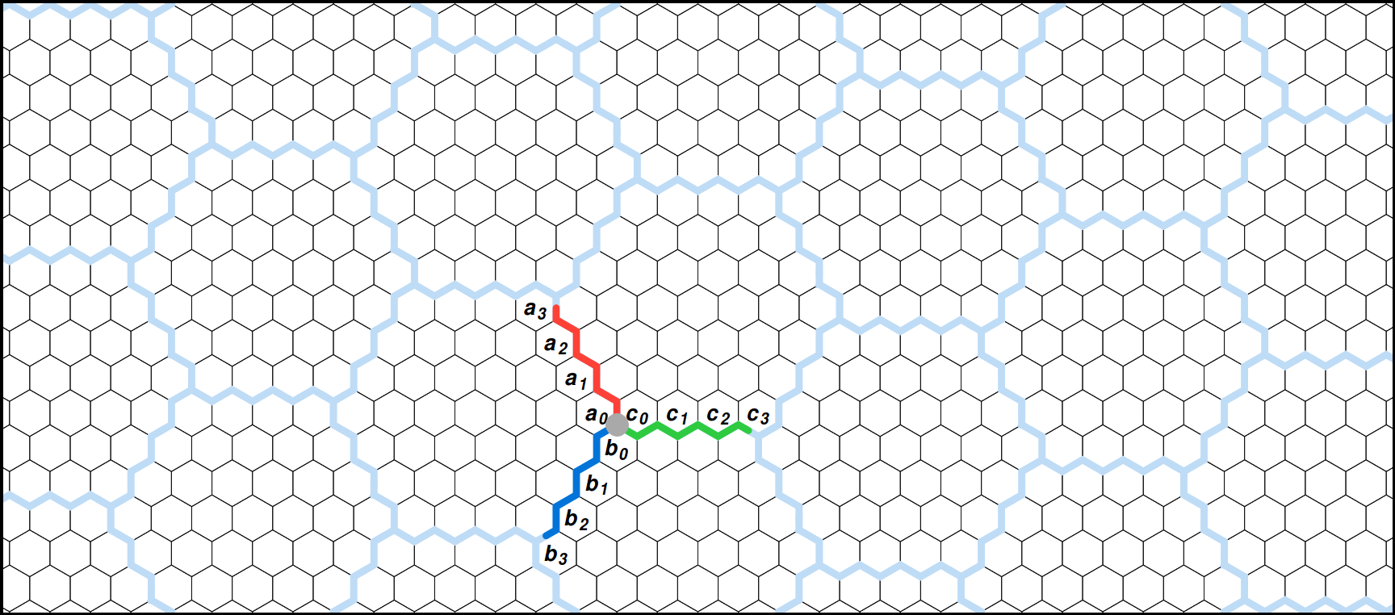
Irregular quasi-hexagonal lattice
A triple-edge modifier is defined by 3 binary words (A,B,C)

Slide 20
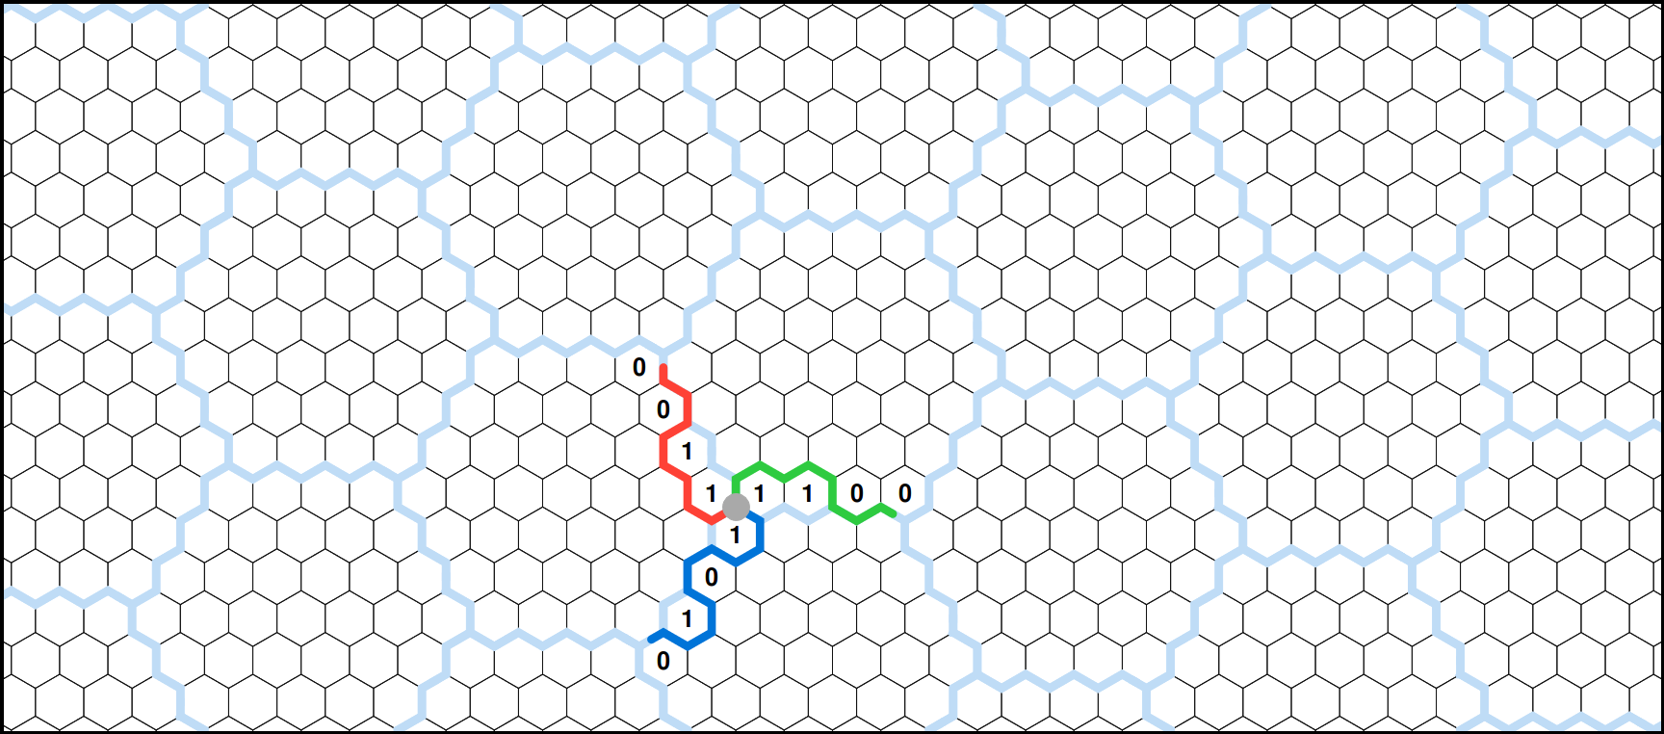
Irregular quasi-hexagonal lattice
These words are randomly set with an equal number of positive bits

Slide 21
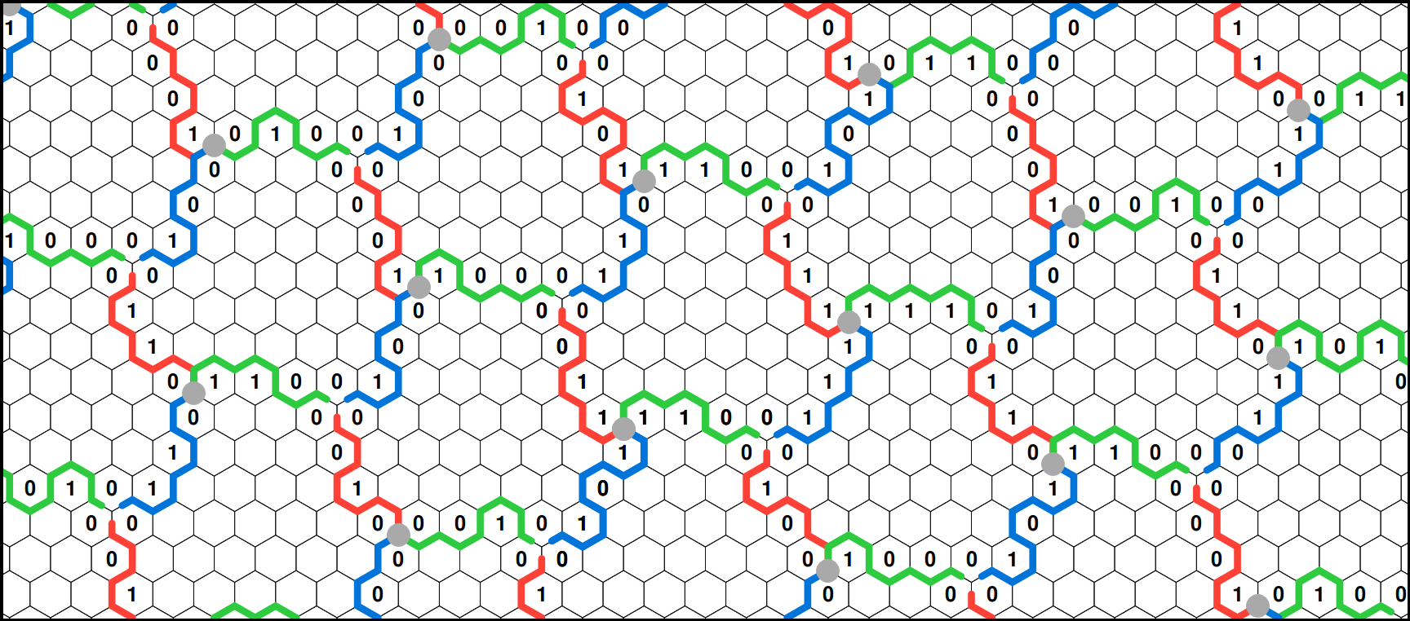
Irregular quasi-hexagonal lattice
Each triple-edge modifiers is randomly picked

Slide 22
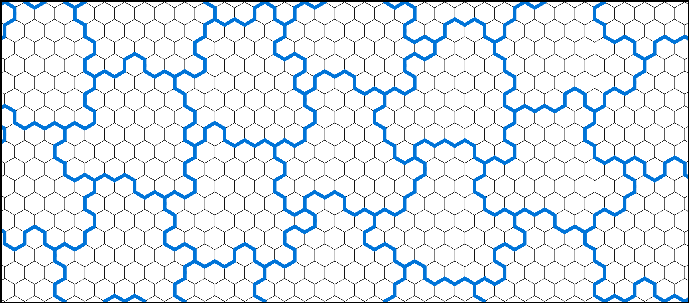
Irregular quasi-hexagonal lattice
This construction guarantees equal capacity for all irregular hextiles

Slide 23
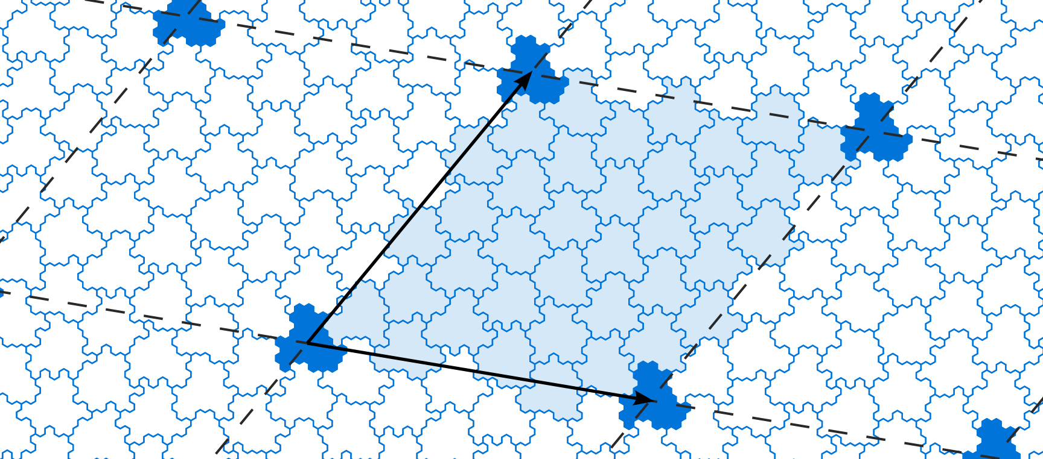
Irregular quasi-hexagonal lattice
Perturbation cover the plane through bi-periodicity

Slide 24
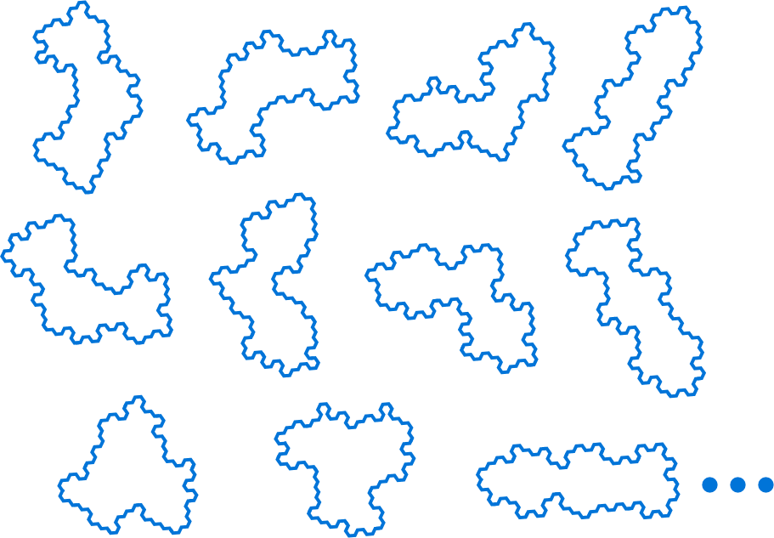
Irregular Polyhexes
Subdivision rule for each irregular trihex
11 ∙ λ possible irregular trihexes

Slide 25
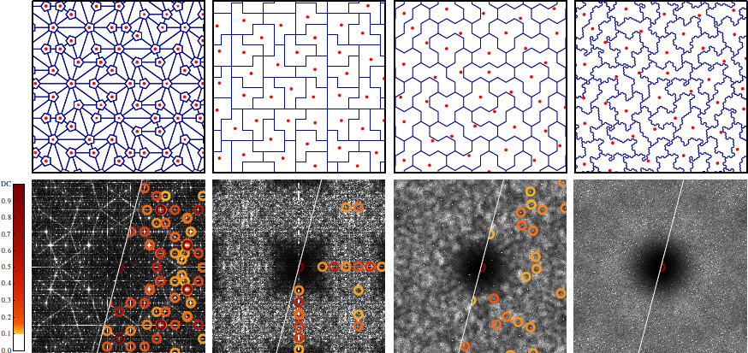
Comparison with previous systems
Penrose
Polyominoes
Trihexes
Irregular Trihexes

Slide 26
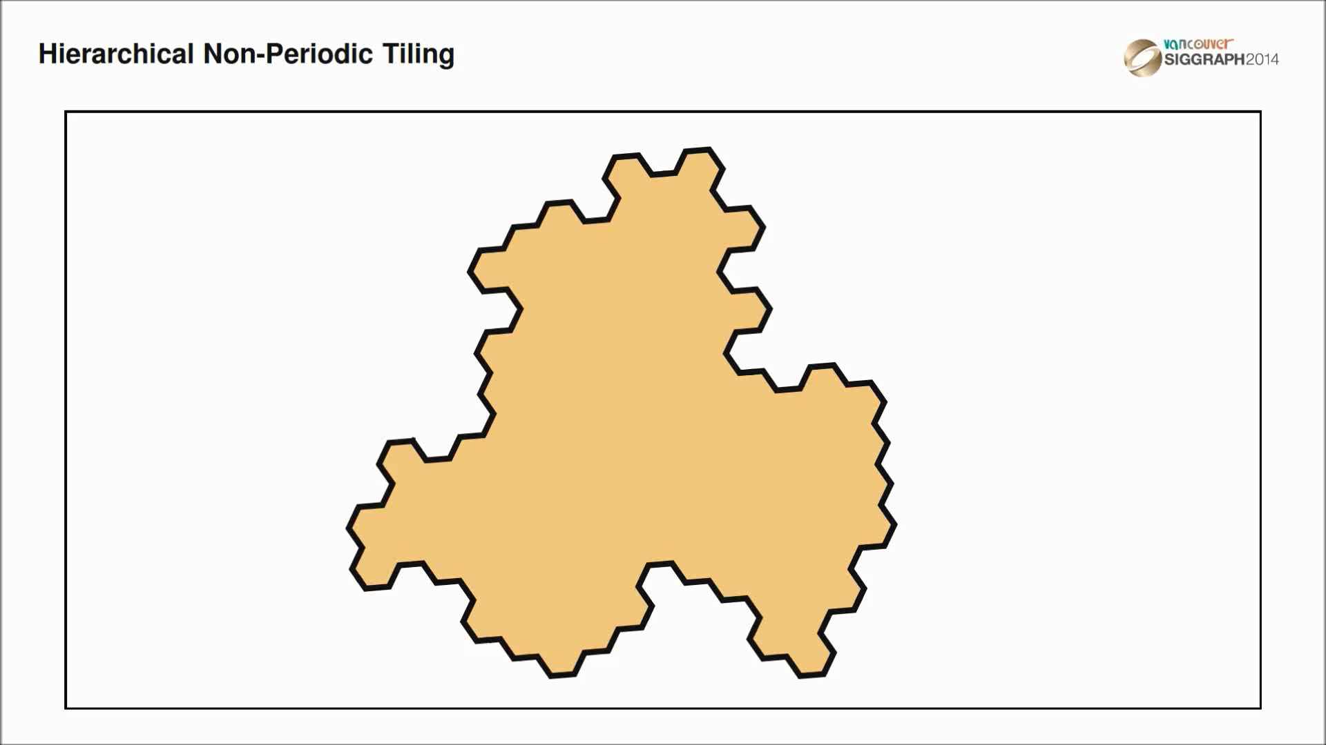
Sampling generation

Slide 27
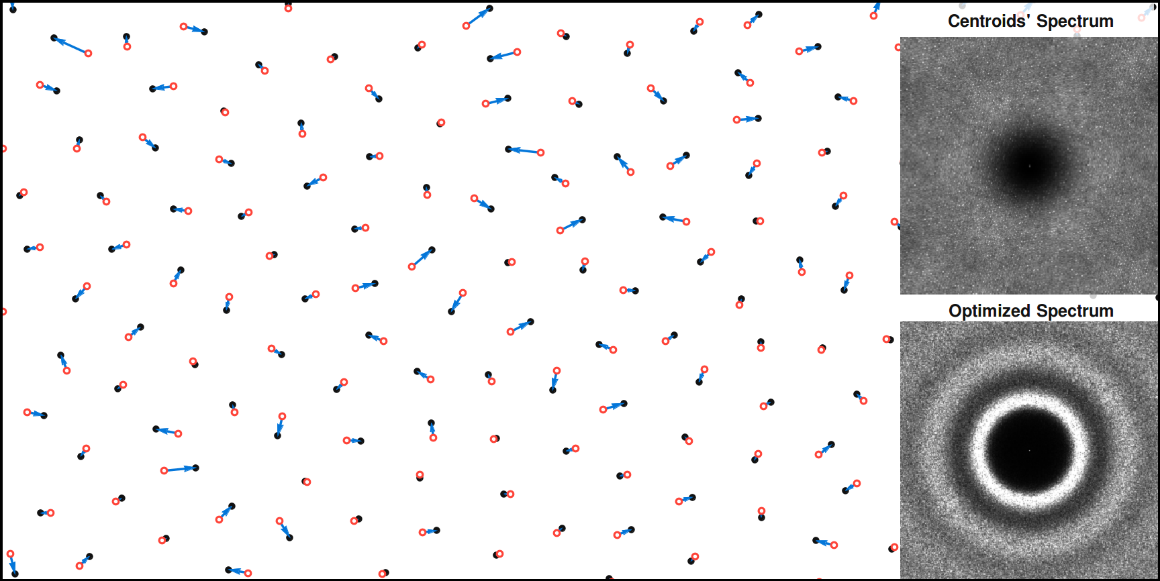
Sampling optimization

Slide 28
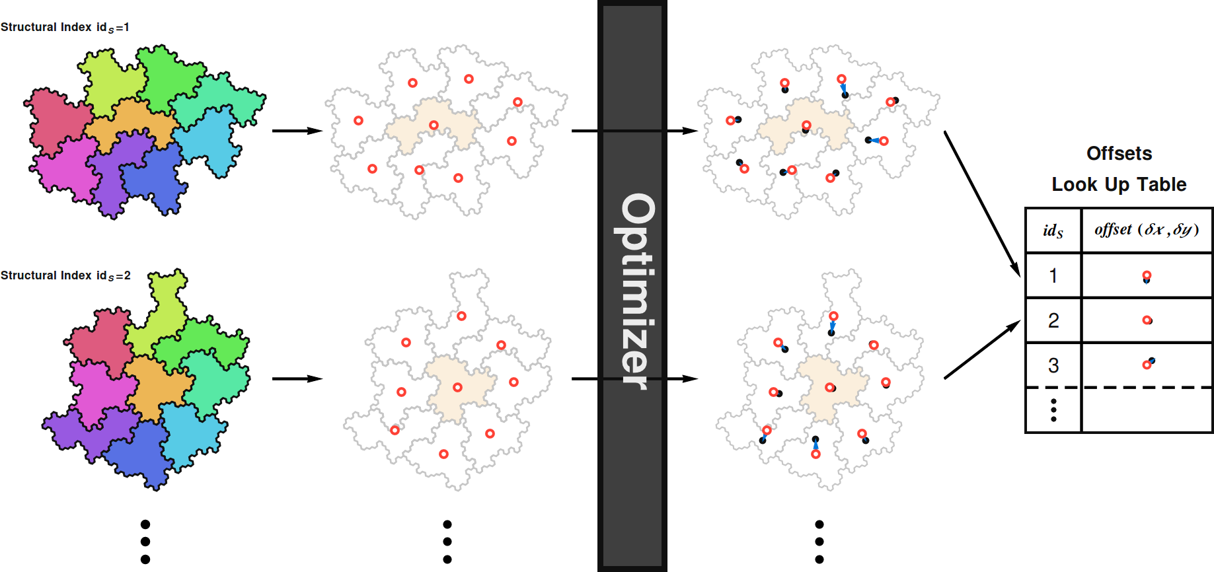
Sampling optimization

Slide 29
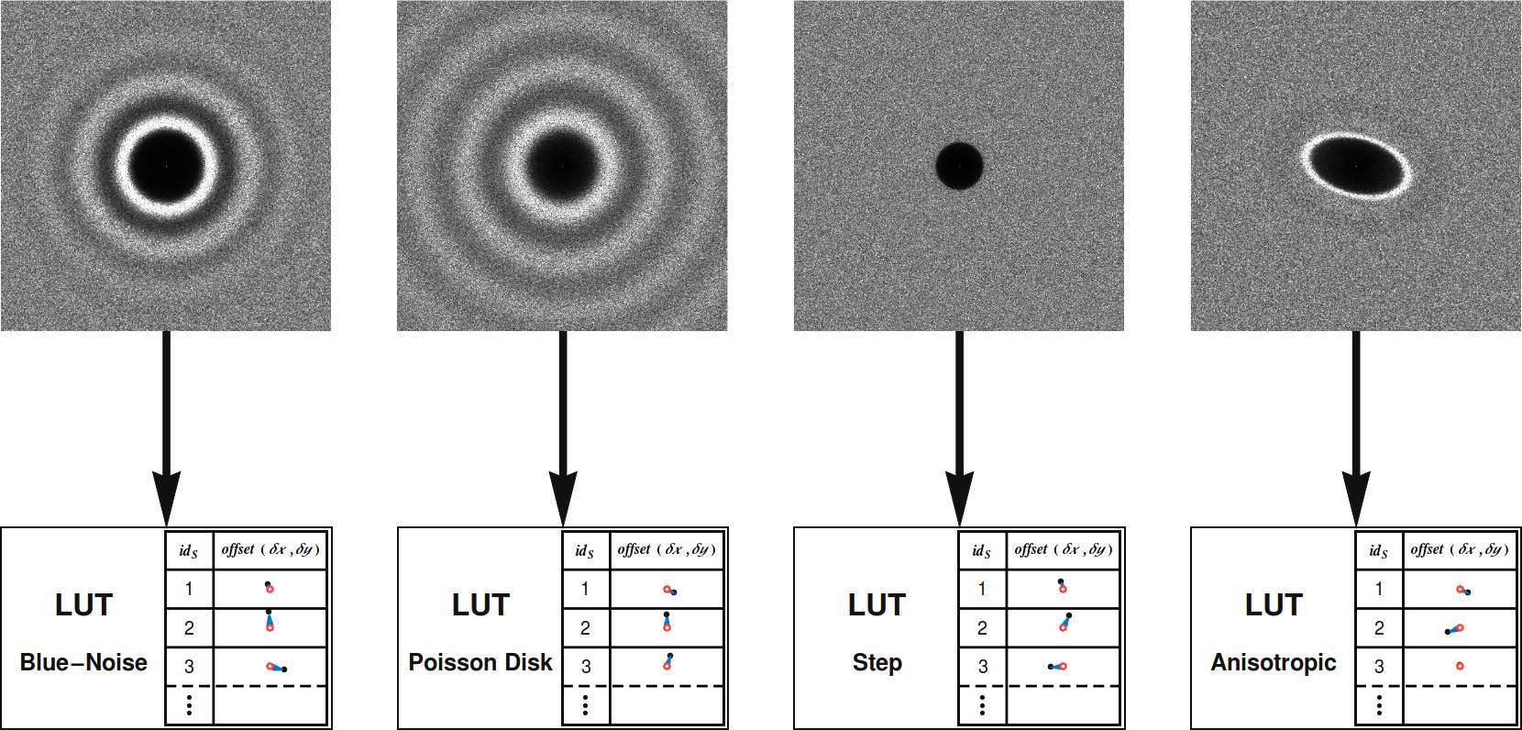
Sampling optimization

Slide 30
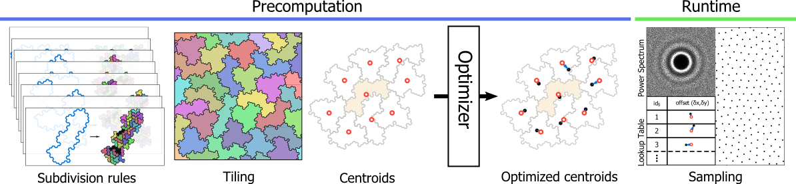
Overall pipeline

Slide 31

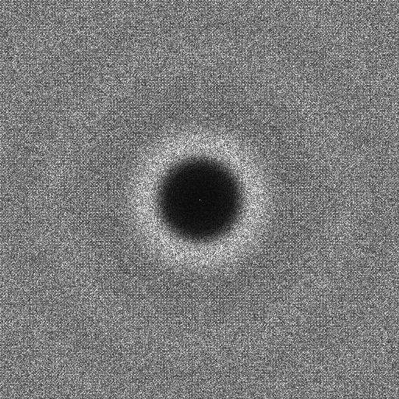

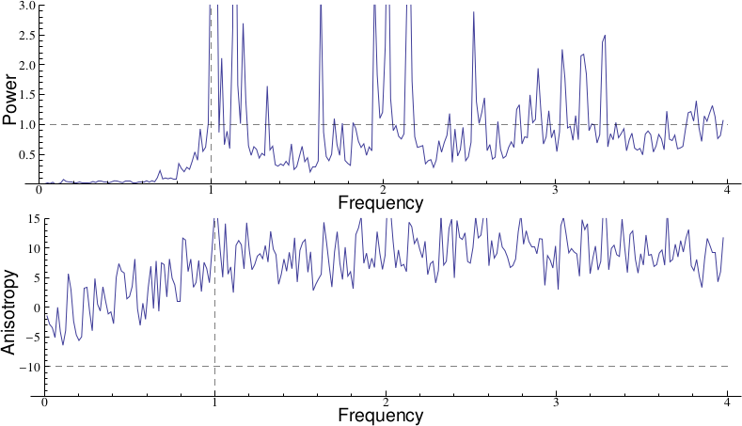
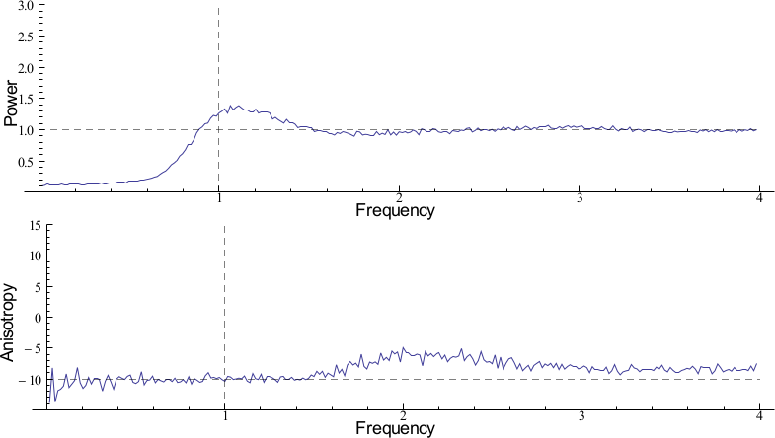

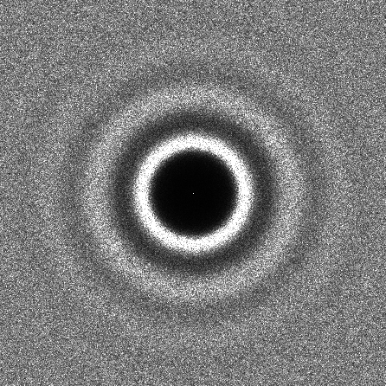

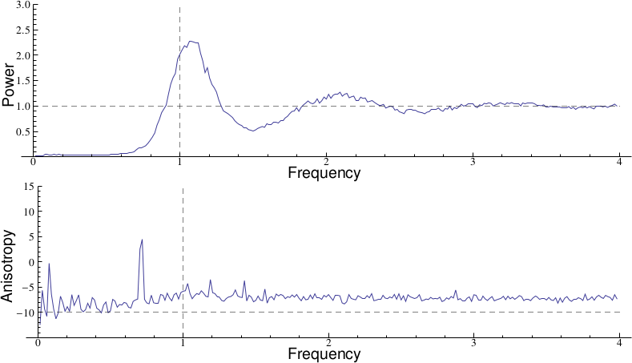
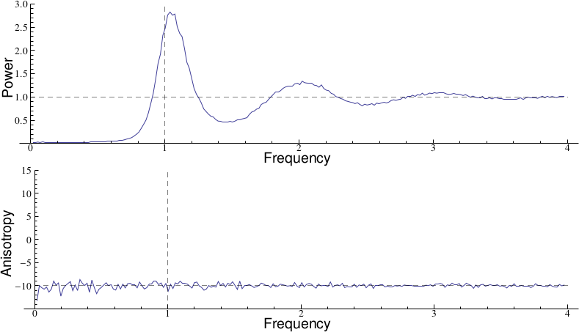
Results
Comparison with previous tile-based sampling methods
Penrose
Wang Tiles
Polyominoes
Our Result

Slide 32
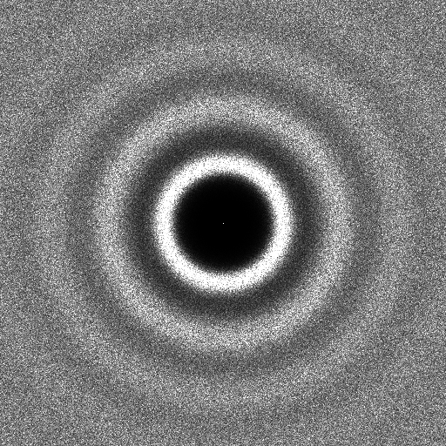

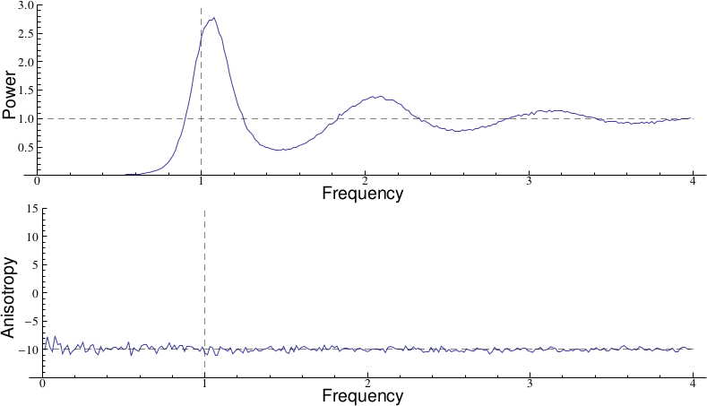
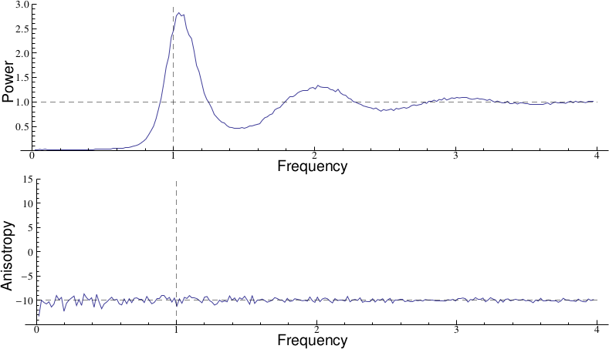
Results
Uniform blue-noise sampling
BNOT [De Goes et al. 2012]
Our Result

Slide 33





Results
Uniform step-noise sampling
Step using [Heck et al. 2013]
Our Result

Slide 34




Results
Examplar-based sampling
Empirical tree distribution in a forest from [Pommerening 2002]

Slide 35
Results
Time in seconds to generate a distribution of N samples
Methods | 10k | 50k | 1M | 10M
CCVT | 157.000 | 4880.000 | - | -
BNOT | 6.000 | 65.000 | 10738.000 | -
General Noise (GPU) | 10.110 | 13.910 | 147.500 | -
Penrose | 0.730 | 4.550 | 11.800 | 80.400
Wang Tiles | 0.004 | 0.018 | 0.345 | 3.420
Polyominoes | 0.053 | 0.254 | 18.900 | 19.600
Ours | 0.016 | 0.067 | 0.989 | 9.280
Optimization-based Methods
Spectral control
Tile-based Methods

Slide 36

Results
Adaptive blue-noise sampling

Slide 37
Contributions
A Novel Tiling System
Centroid Spectrum Free of Spurious Peaks
Hierarchical
Non-periodic
A Novel Sampling System
Spectral Control
Adaptive
Fast ( > 1M points /sec. /core )
Supplementary material and source code: http://liris.cnrs.fr/polyhex

